Slide 1

How To Create The Death Star in TinkerCAD By: Peter Davis, Ato Koomson, and Huyen Pham

Slide 2
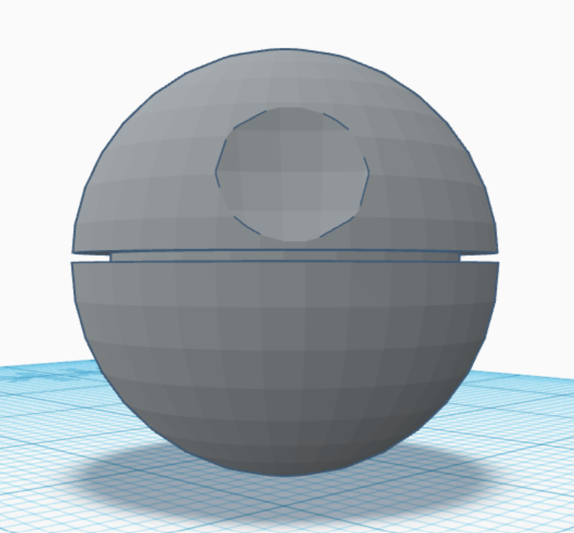
This PowerPoint serves as a tutorial for building the Death Star in TinkerCAD

Slide 3

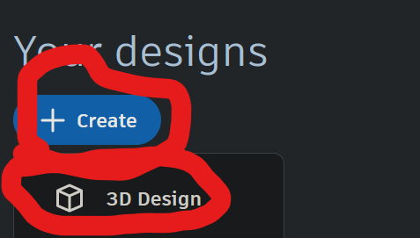
Go to tinkercad.com and create a free personal account. Once in, create a 3D design.

Slide 4
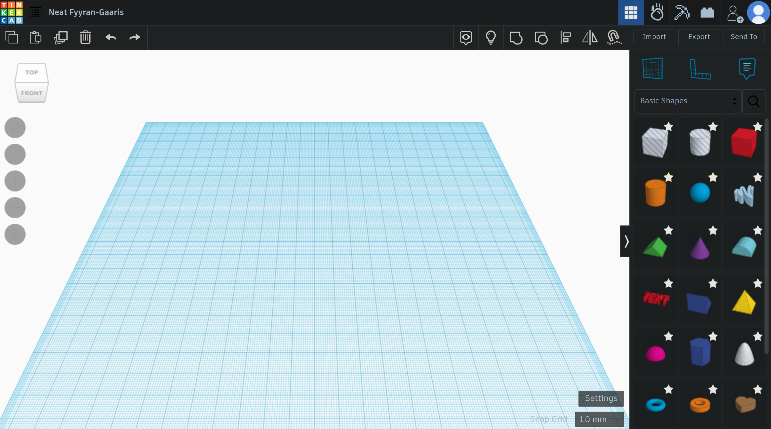
You will be greeted with a screen that looks as depicted. Note the cube in the top left corner, it is for changing your view. It will be critical later.

Slide 5
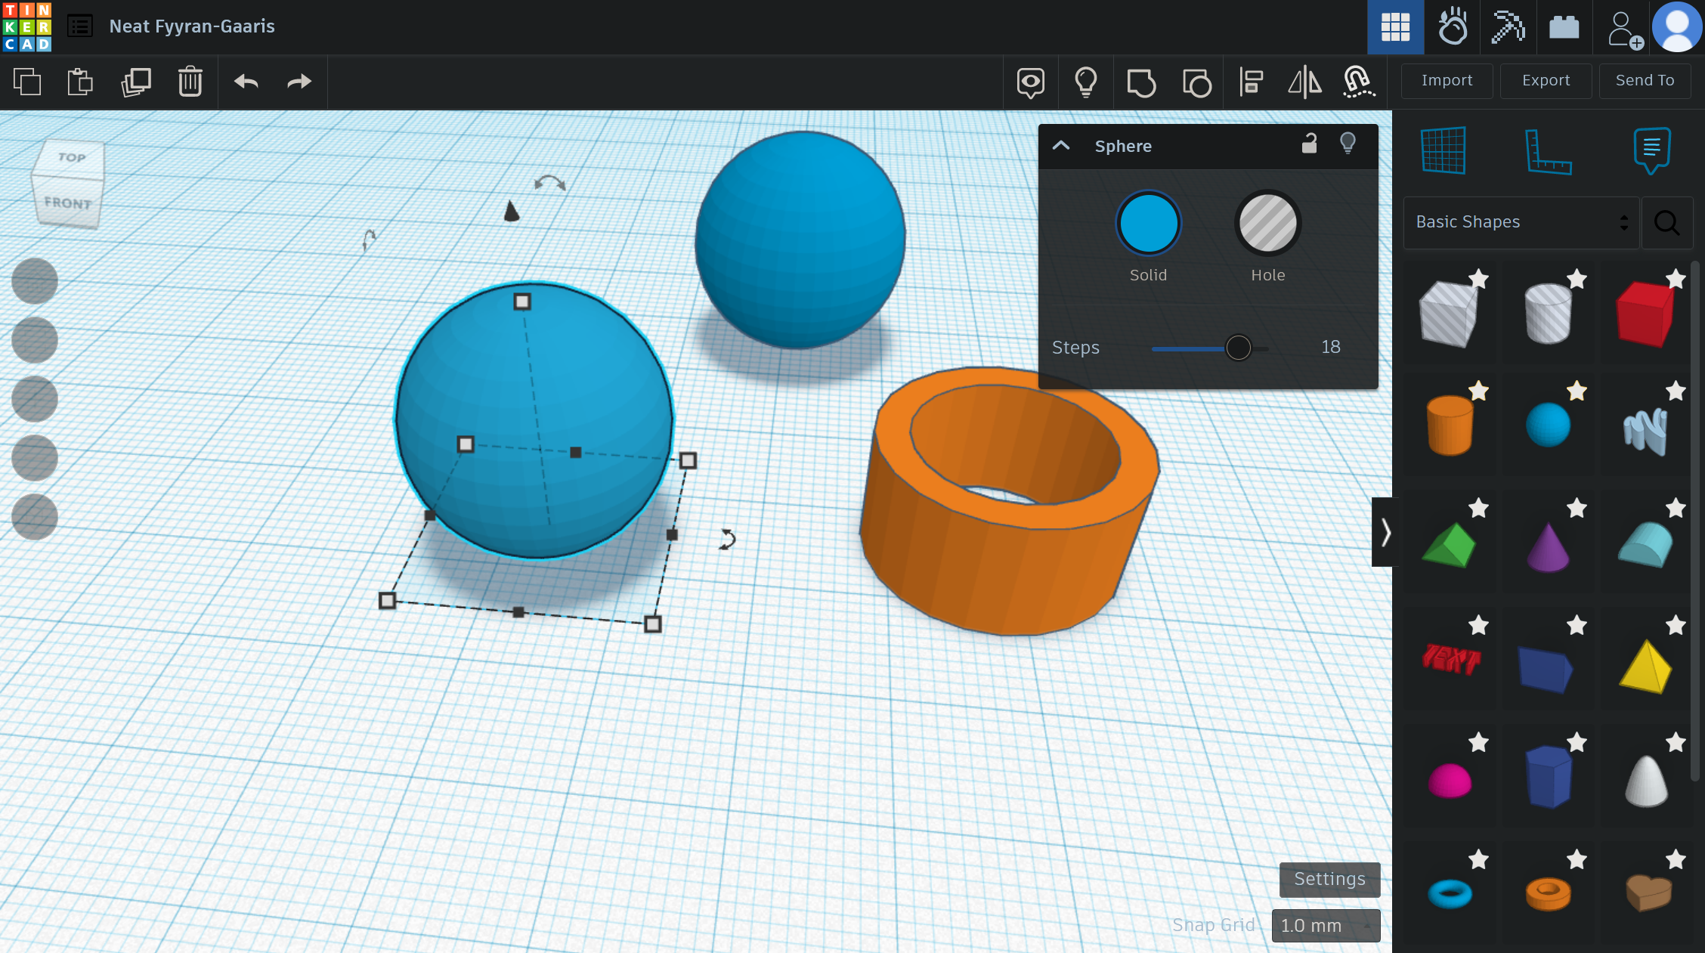
Drag 2 spheres and a tube into the workplane from “Basic Shapes”. With one of the shapes selected, press the F key on your keyboard to center it on your screen.

Slide 6
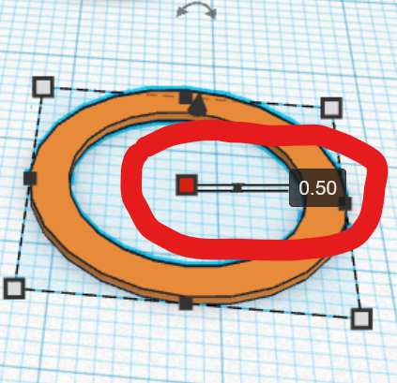
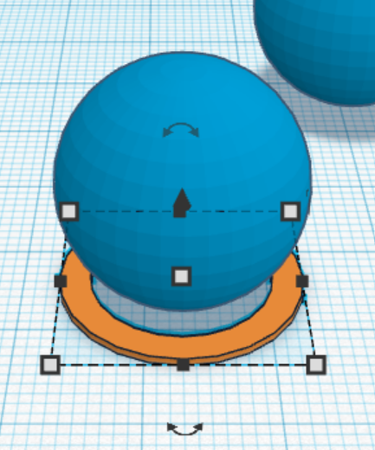
Select the top-center handle on the tube to open a dialogue box (just like a word document). Enter .5 to adjust the height to half a millimeter.
Click and drag the tube under one of the spheres. Use the cube to adjust perspective, your scroll wheel for zooming in and out, and the F key to center for ensuring alignment.

Slide 7
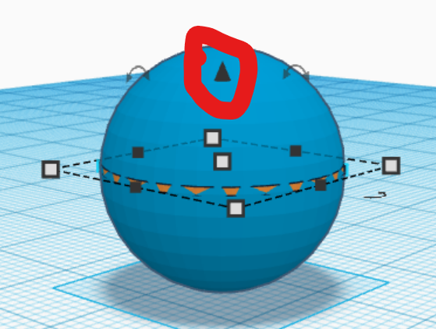
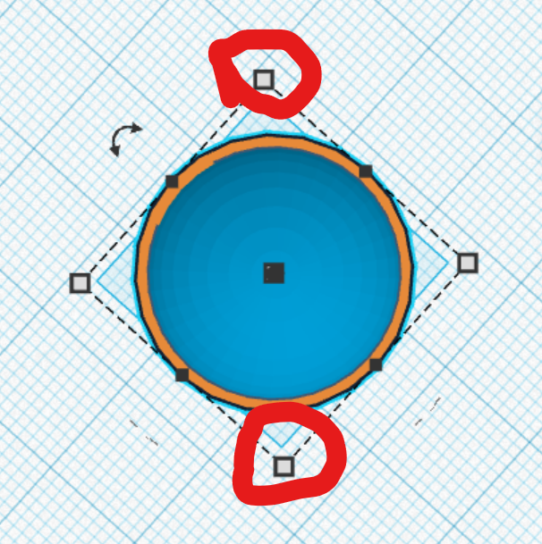
Use the cone floating above the tube to elevate it to the middle of the sphere.
Pull on opposing corner handles to make the walls of the tube stick out of the sphere.

Slide 8
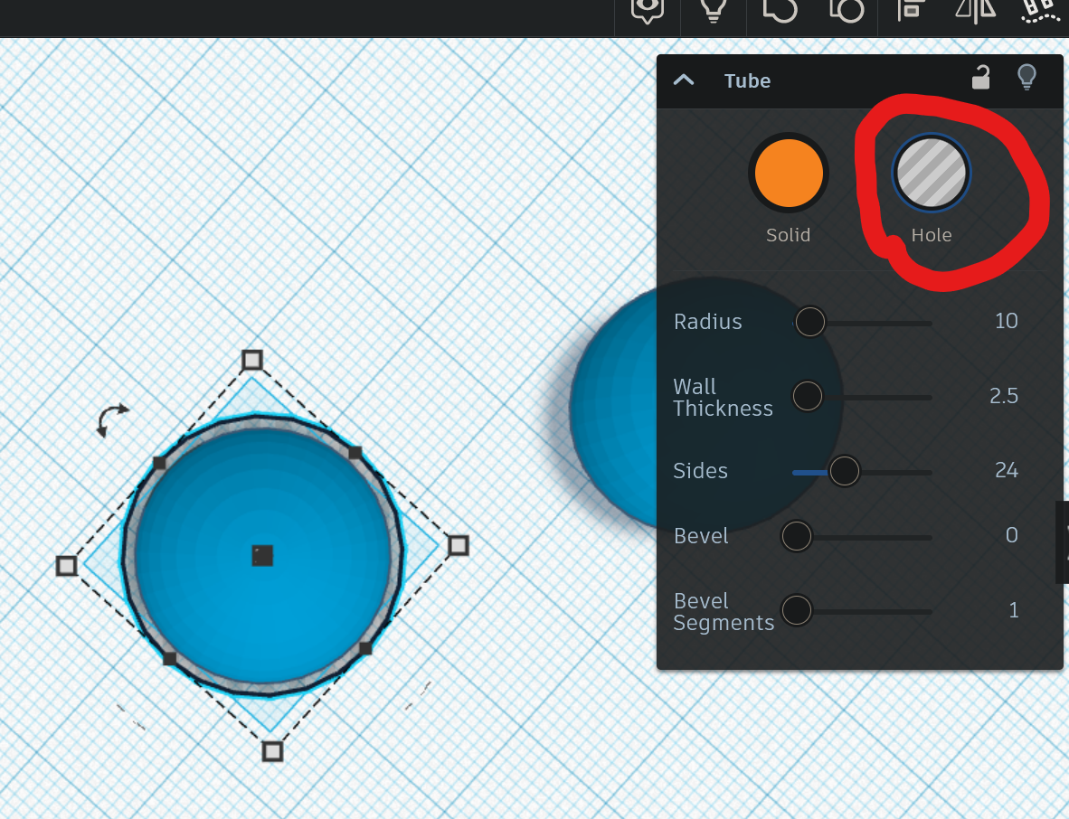
Turn the tube into a hole. This makes it remove material at the intersection of shapes.

Slide 9
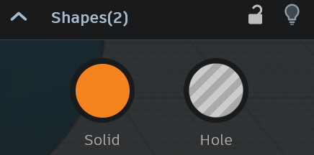
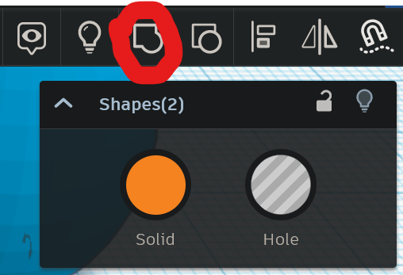
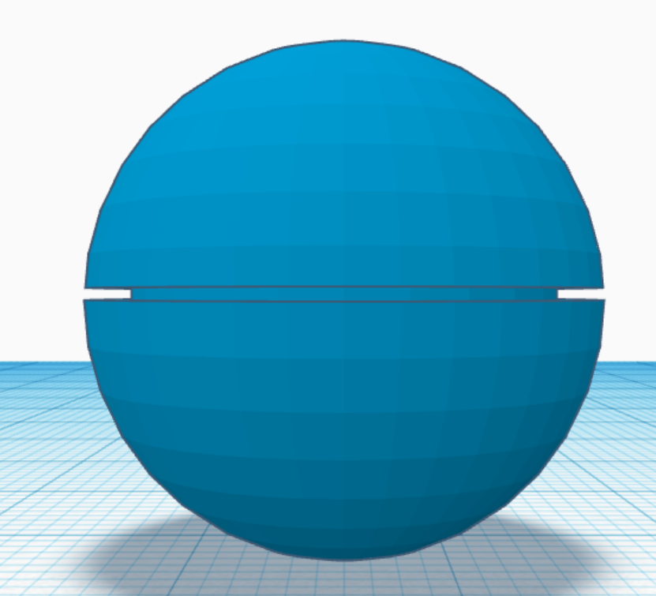
With one shape selected, hold shift as you click the other. The top right corner of the screen should say “Shapes(2)”
Click the “Group” button to group the shapes into an object.
Your sphere should look something like this:

Slide 10
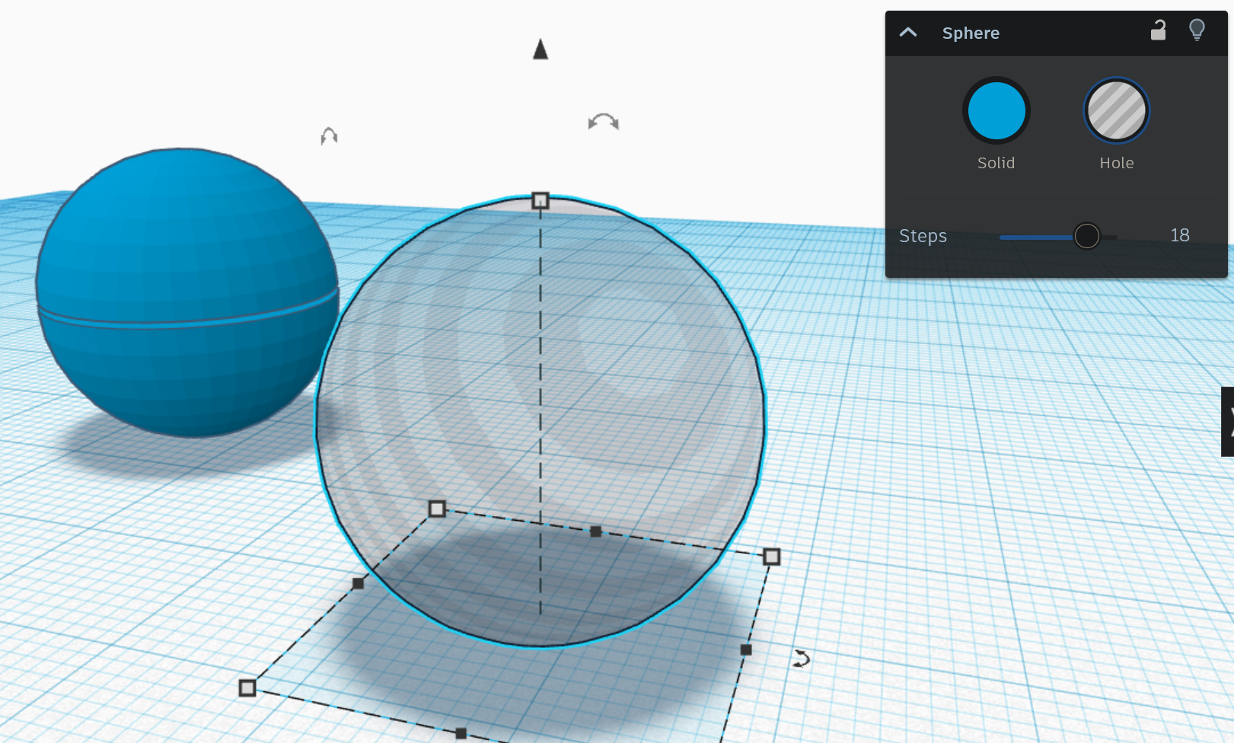
Make the second sphere a hole.

Slide 11
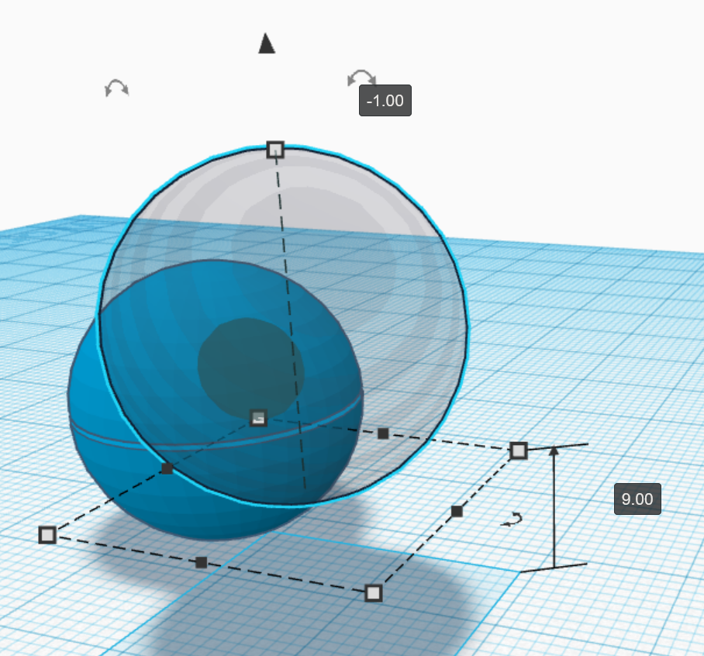
Use the cone, as well as clicking and dragging, to align the spheres. The gray area will be what is taken out when you join the shapes, so make sure it’s as big as you want and in the right place.

Slide 12
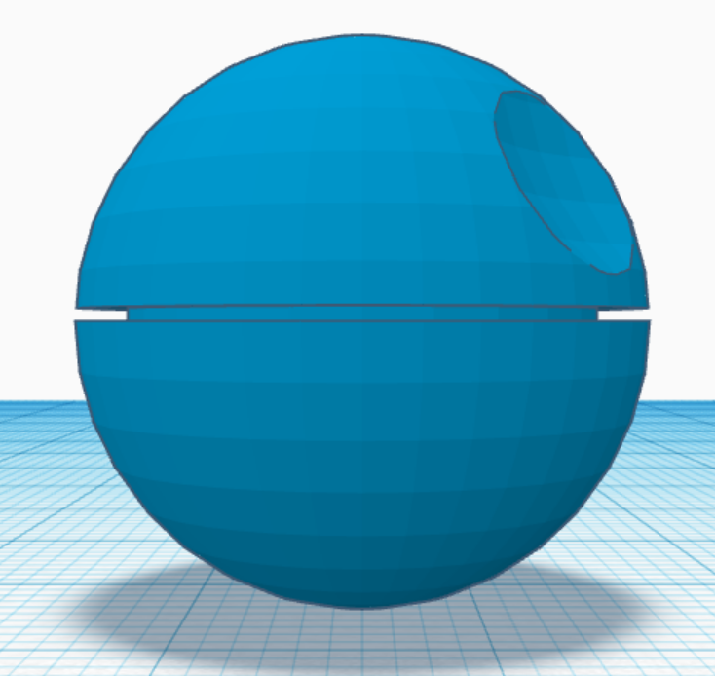
After grouping, your object should look something like this:

Slide 13
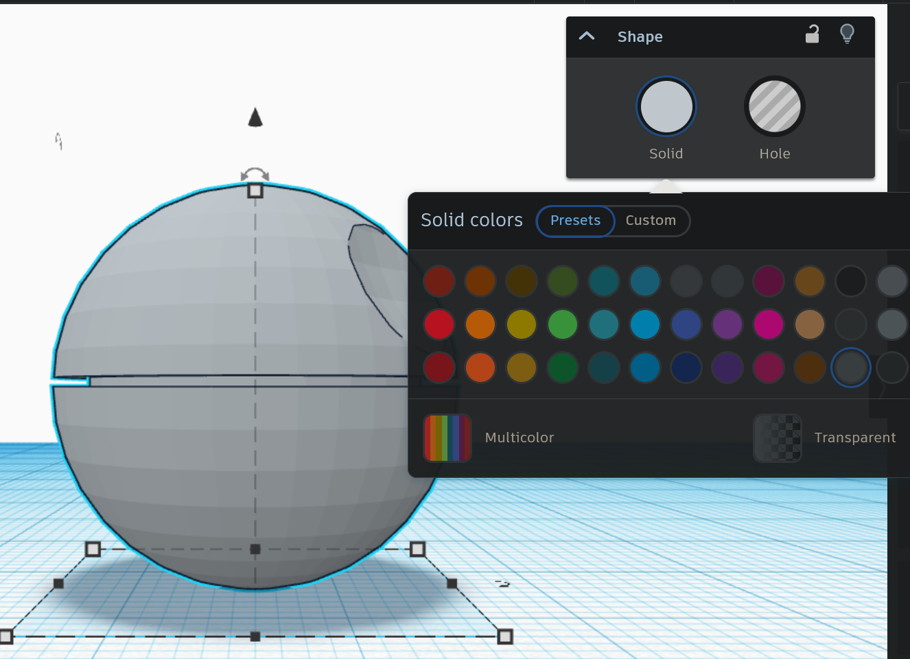
You can change the color of your Death Star by clicking “Solid” and selecting a color.

Slide 14
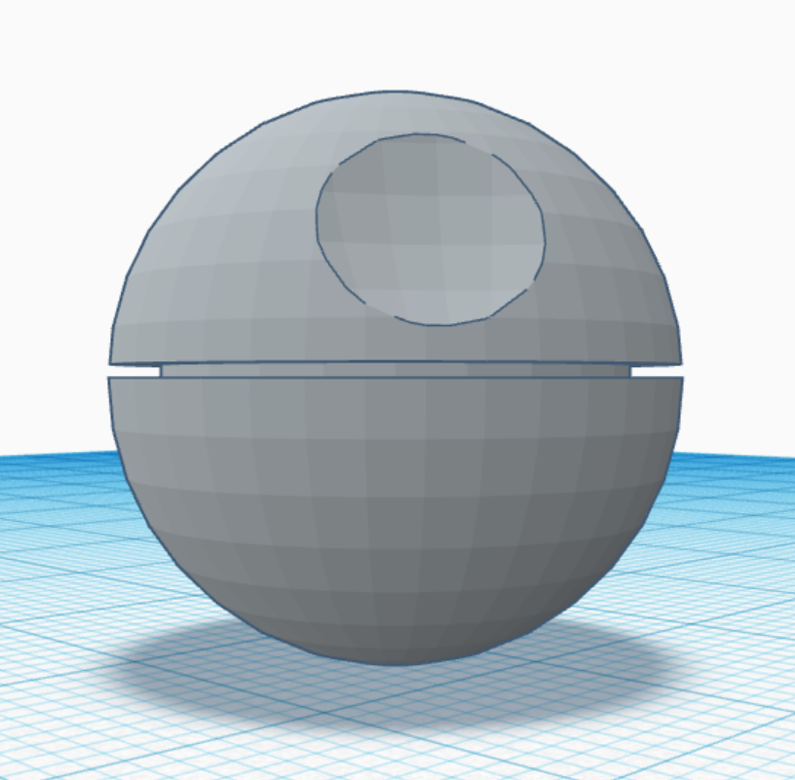
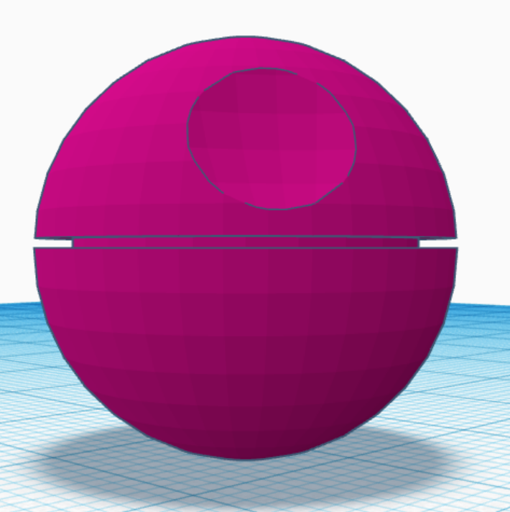
Congratulations, you’ve drawn a replica of the Death Star

